Slide 1
The Rhetorical Structure of Attribution
Andrew Potter Department of Computer Science & Information Systems
University of North Alabama
Florence, Alabama, USA
apotter1@una.edu

Slide 2
Attribution
A relation
  Between a statement or belief
  And the agent making the statement or holding the belief
The agent
  Usually a person or group of people
The statement or belief
  Quote, paraphrase, cognitive predicate
The relation
  An RST relation?

Slide 3
Relational status of Attribution
A matter of debate…
Some arguments based on grammatical or syntactical features
  Acceptance, delimited to clausal complements
  Excluding infinitival complements or noun phrases
    (Carlson & Marcu, 2001; Wolf & Gibson, 2005)
  Rejection because attributed material is not a discourse unit, but usually a clausal complement
    (Stede, Taboada, Das, 2017)
Others more closely aligned with the RST fundamentals
  Rejection due to inattention to the intended effect (Stede, 2008)
  Rejection due to lack of relational propositions (Mann & Thompson, 1987)
Or…
  Acceptance as carriers of coherence structures (Wolf & Gibson, 2005 )
  Acceptance, labeling the relation between a reporting and a reported clause
  (Marcu, 1999)

Slide 4
Approach – classical RST
Analysis of intended effect
Fundamental to understanding the organization of a text
Accounts for how intended effects are realized through relational propositions, and thus serves as a general theory of writers' goals
And yet the primacy of intended effect is rarely mentioned in discussions of attribution.
  Not explicit among the reasons Mann and Thompson (1987) identified for rejecting it
  Neither Carlson and Marcu (2001) nor Redeker and Egg (2006) mention it. Wolf and Gibson (2005) do not mention it
  Nor do Sanders, Spooren, and Noordman (1992) nor Das, Taboada, and Stede (2017)
  Stede (2008) calls attention to the lack of nuclear constraints and inattention to intended effect
  a view shared by da Cunha and Iruskieta (2010)
For the most part intended effect, so fundamental to RST, has been ignored.
Explore attributional relations from the perspective of intended effect

Slide 5
Some core issues
Discourse Units
  Can we segment attributive statements?
  Can we construe the constituents as discourse units?
Nuclearity
  Which part is the satellite?
  And which the nucleus?
Relation Identification
  What are the constraints, and what are the intended effects?
  Is there only one Attribution relation, or are there other possibilities?

Slide 6
Discourse units
For attribution to be a relation, the parts must be discourse units
Mann and Thompson (1987) rejected attribution predicates
  They do not constitute distinct entities
  They are part of the proposition that contains the attributed material
Stede et al. (2017) rejected the attributed material
  For syntactical reasons
  Attributed material is a clausal complement of the attribution predicate
What is and what is not … ?
However, given that the standards for what constitutes a discourse unit are somewhat unstable in their own right, this too leaves one on uncertain ground (Degand & Simon, 2009).
But if relational propositions are discoverable between attributions and the attributed material, the constituents of that relation may be treated as discourse units

Slide 7
Nuclearity – a problem
Attribution predicate as satellite and attributed material as the nucleus
  Carlson and Marcu (2001)
Can lead to difficulties
  When the attribution predicate is a cognitive predication
  And more salient than the attribution material
    Redeker and Egg (2006)
Yet assigning nuclearity to the predicate also presents difficulties, e.g.
  Senator Chris Coons, the Delaware Democrat, told me
  that his longtime colleague [Senator Lindsey Graham] is “hysterically funny” and “personally engaging.”
The attribution predicate (1) would be marked as nucleus
But it is the assessment of Graham that is more salient

Slide 8
Nuclearity – a solution
A false dilemma
Attributions are asymmetric
But no single pattern of asymmetry
However, the inference to be made is not that Attribution is not a discourse relation
Although attribution is relational, the relation is not necessarily Attribution per se
Attribution is but one among several attributional relations

Slide 9
Relation identification – a problem
Identifying attributions seems fairly straightforward
  Based on the presence of attribution verbs or cognitive predicates
But provides no assurance that an attribution is Attribution
Identification of intended effect is essential
Otherwise, it cannot be presumed that there is any RST relation whatsoever

Slide 10
Relation identification – a solution
Locating intended effect
  The writer’s or the source’s
  Is the writer merely reporting the attribution phenomena?
  Or is the writer leveraging the attribution to change reader positive regard?
Attributions may be to the first person, second person, or third person
Attributions occur within the discourse context
Attributions are used to achieve a range of effects

Slide 11
Some attribution relations
Justify
Evaluation
Interpretation
Cause
Elaboration
Evidence
Attribution
…
(Faux) Concession
“Clearly, as usual, there will be borderline cases” (Mann, 2001)

Slide 12
Attribution as Justify
The authority to speak
  Established by education, role, contract, expertise… (Mann, 2001)
Borrowed authority
  Established by attribution
In Carlson and Marcu’s example
  Analysts estimated that sales at U.S. stores declined in the quarter, too
  The assumption that they were financial analysts provides credibility
Borrowed authority also occurs in the use of citation
  Although highly formalized, citation is essentially rhetorical in nature (Connors, 1998)

Slide 13
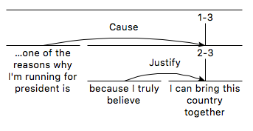
Attribution as Justify (2)
Attribution as Justify in expressions of cognitive acts
  When US politician Kirsten Gillibrand declared that
  An intended effect is that the audience should also accept that she can achieve that lofty goal
“Persons are authorities about their private thoughts and feelings” (Mann, 2001)

Slide 14
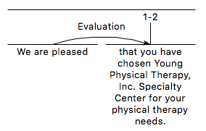
Attribution as Evaluation
Evaluation as cognitive predicate
The satellite assesses the nucleus
The reader will recognize the pleasure the writers take in having a new client

Slide 15
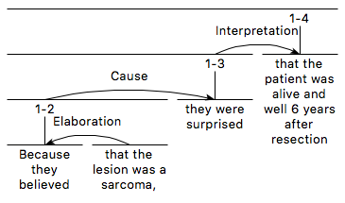
Attribution as Interpretation
R recognizes that S relates N to a framework of ideas not involved in the knowledge presented in N itself
The survival of the patient
seems central to the text
Paraphrase:
  The patient was alive and after six
  years
  THUS,
  because they believed that the
  lesion was a sarcoma,
  they were surprised

Slide 16
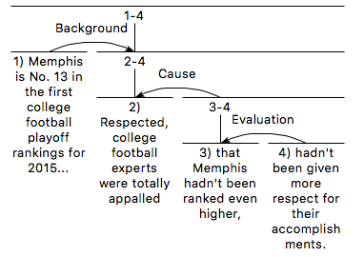
Attribution as Cause
Attributed material as Cause of a cognitive state
Rhetorical salience is on the attribution predicate
  The low ranking assigned to the team caused outrage among experts

Slide 17
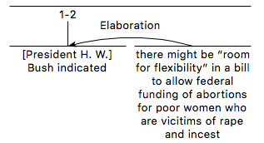
Attribution as Elaboration
The attributed material provides information about the activity identified in the attribution predicate
Because the source was a
US president, the attribution
might seem to be Justify
  But Bush is not the writer
  The writer is merely reporting
  what Bush said

Slide 18

Cognitive States as Elaboration
Attributions as elaborations also include cognitive states, such as thinking and believing
The satellite identifies what they believed
Presumably this belief or thought is one among many
Elaboration specifies that the reader will recognize that the satellite provides additional detail for the nucleus

Slide 19
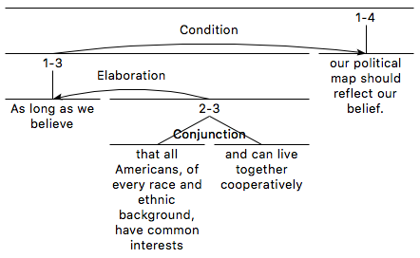
Cognitive States as Elaboration
This accords with Redeker & Egg’s claim
  Attribution predicate as nucleus
The Condition relation cannot be modeled using Marcu-style analysis

Slide 20
Attribution as Evidence
  “Sure I’ll be polite,”
  promised one BMW driver
  who gave his name only as Rudolf
  “As long as the trucks and the timid stay out of the left lane.”
Segments 2-3 interrupt the reported text
  Wolf and Gibson (2005) cite it as containing cross dependencies
  Carlson and Marcu’s (2001) Attribution splits the nucleus
Redeker and Egg (2006) reverse the nuclearity
And move the embedded segments outside of the enclosing text, as proposed by O’Donnell (1997)

Slide 21
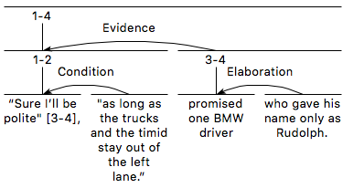
Attribution as Evidence
The quote asserts a claim
  The Condition is IFF
The attribution lends
credibility to the claim

Slide 22
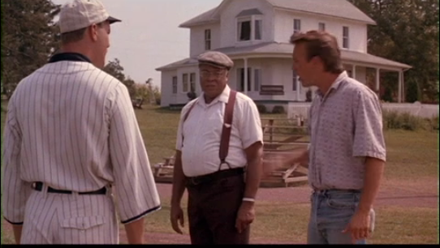
Cognitive states as (faux) Concession
Appear to moderate a claim with an indication of uncertainty
  Have you been to Cancun before - if not I think you might want to reconsider using it as a base. It is heavy traffic, and positively the worst resort I ever went [to] in my life - overdeveloped and literally raping you for every dollar to be had.
  I think you'd better stay here, Ray
    Field of Dreams
  I think that it is time that teachers of
  geometry became a little more ambitious
    G.H. Hardy
  These latter two could be Justify?

Slide 23

Attribution as Attribution
Katsumoto says to Nathan on the dawn of battle,
“You think a man can change his destiny?”
to which Cruise replies,
“I believe a man does what he can,
until his destiny is revealed.”
The passage seems structurally ambiguous (Stede et al., 2017)
  The attribution predicates are in a relationship to each other
  And the attributed material and the attribution predicates are related
The relationships between material and predicates seem little more than attributive

Slide 24
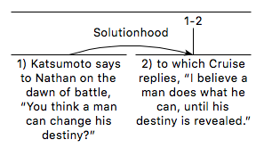
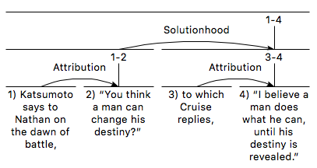
Attribution as
Attribution
Non-Attributive
(Taboada & Hay, 2008)
Attributive

Slide 25
Attribution as Attribution
The intended effect seems more than who-said-what
The satellites support the exchange between Katsumoto and Nathan (Cruise) by engaging the reader in the drama (on the dawn of battle),
Increasing reader interest
Akin to Preparation

Slide 26
Conclusion (1)
Writers use attributions for diverse purposes
Attribution predicates and attributed material engage in RST relations
Nuclearity depends on the relation
 | Nuclearity
Relation | Attribution Material | Attribution Predicate
Justify | X
Evidence | X
Evaluation | X
Interpretation | X
Attribution | X
Elaboration |  | X
Cause |  | X
There may be more…

Slide 27
Conclusion (2)
Some of the criteria used by Carlson and Marcu for excluding certain constructs as relations may need revisiting
  Exclusion of infinitival complements, attribution predicates that do not identify a source, and passive constructions
It is hoped that other Japanese would then follow the leader
The apparent anonymity suggests difficulty in determining whether the writer is among those holding the attributed material in positive regard
It is clear that someone does
Evaluation or Interpretation – difficulty in choosing between these is not sufficient to rule that it is neither
(In this example, the context identifies the parties doing the hoping as unnamed Mexican officials)

Slide 28
Conclusion (3)
Analyses using intended effect continues to be useful
From such studies emerge new desiderata for development of scalable methods

Slide 29
Further Study
Polarity
Counterfactuals
Concession
Propositional attitudes
  …if we had confidence that the President clearly did not commit a crime, we would have said that
    Robert S. Mueller III
  In my humble opinion, the uber-rich… should be both thankful and generous
  …I believe he said that number would double again by 2022. I may be mistaken if it was actually Musk that made that last comment
  I believe he really believes that he has a very good team this year
  I wish I might think that I should bring you a little
    Henry James, The Aspern Papers

Slide 30
References (See the paper for complete list)
Carlson, L., & Marcu, D. (2001). Discourse tagging reference manual (TR-2001-545). Marina del Rey, CA: USC Information Sciences Institute.
Connors, R. J. (1998). The rhetoric of citation systems—Part I: The development of annotation structures from the renaissance to 1900. Rhetoric Review, 17(1), 6-48. doi:10.1080/07350199809359230
Das, D., Taboada, M., & Stede, M. (2017). The good, the bad, and the disagreement: Complex ground truth in rhetorical structure analysis. Proceedings of the 6th Workshop on Recent Advances in RST and Related Formalisms (pp. 11-19).
da Cunha, I., & Iruskieta, M. (2010). Comparing rhetorical structures in different languages: The influence of translation strategies. Discourse Studies, 12(5), 563.
Mann, W. C. (2001, April 2). Authority to speak: The Justify relation -- some issues. RSTlist. Retrieved from http://listserv.linguistlist.org/pipermail/rstlist/2001-April/000091.html
Mann, W. C., & Thompson, S. A. (1987). Rhetorical structure theory: A theory of text organization (ISI/RS-87-190). Marina del Rey, CA: University of Southern California, Information Sciences Institute (ISI).
Marcu, D. (1999). A decision-based approach to rhetorical parsing Proceedings of the 37th Annual Meeting of the Association for Computational Linguistics (pp. 365-372). College Park, Maryland: Association for Computational Linguistics.
Redeker, G., & Egg, M. (2006). Says who? On the treatment of speech attributions in discourse structure. In C. Sidner, J. Harpur, A. Benz, & P. Kuhnlein (Eds.), Constraints in discourse (pp. 140-146). Maynooth: National University of Ireland.
Sanders, T. J. M., Spooren, W. P. M., & Noordman, L. G. M. (1992). Toward a taxonomy of coherence relations. Discourse Processes, 15, 1-35.
Stede, M. (2008). Disambiguating rhetorical structure. Research on Language and Computation, 6(3), 311-332.
Stede, M., Taboada, M., & Das, D. (2017). Annotation guidelines for rhetorical structure. Potsdam and Burnaby: University of Potsdam and Simon Fraser University.
Taboada, M., & Hay, M. (2008). Simon Fraser University Review Corpus: RST annotations. Retrieved from: https://www.sfu.ca/~mtaboada/SFU_Review_Corpus.html
Wolf, F., & Gibson, E. (2005). Representing discourse coherence: A corpus-based analysis. Computational Linguistics, 31(2), 249-287.

