Slide 1
Riemannian Normalizing Flow on Variational Wasserstein Autoencoder for Text Modeling
Prince Wang, William Wang
UC Santa Barbara

Slide 2
Outline
VAE and the KL vanishing problem
Motivation: why Riemannian Normalizing flow/WAE
Details
Experimental Results

Slide 3
VAE: KL vanishing
Can generate sentences given latent codes z
i were to buy any groceries .
horses are to buy any groceries .
horses are to buy any animal .
horses the favorite any animal .
KL term, gap between posterior and prior

Slide 4
Previous works
Generating sentences from Continuous Space, (2015, Bowman)
Improved Variational Autoencoder for text Modeling using Dilated Convolution, (2017, Yang)
Spherical Latent Spaces for Stable Variational Autoencoder, (2018, Xu)
Semi-Amortized VAE, (2018, Kim)
Cyclical Annealing Schedule: A Simple Approach to Mitigating KL Vanishing, (2019, Fu)

Slide 5
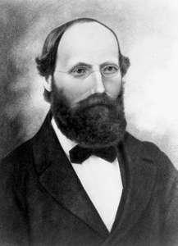
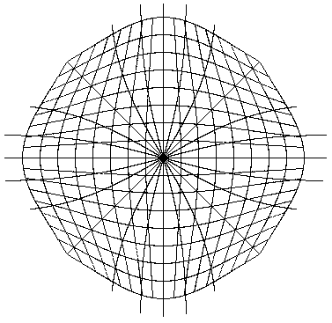
Riemannian Normalizing Flow/Wasserstein Distance

Slide 6
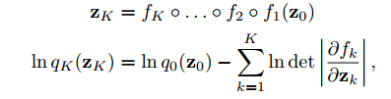
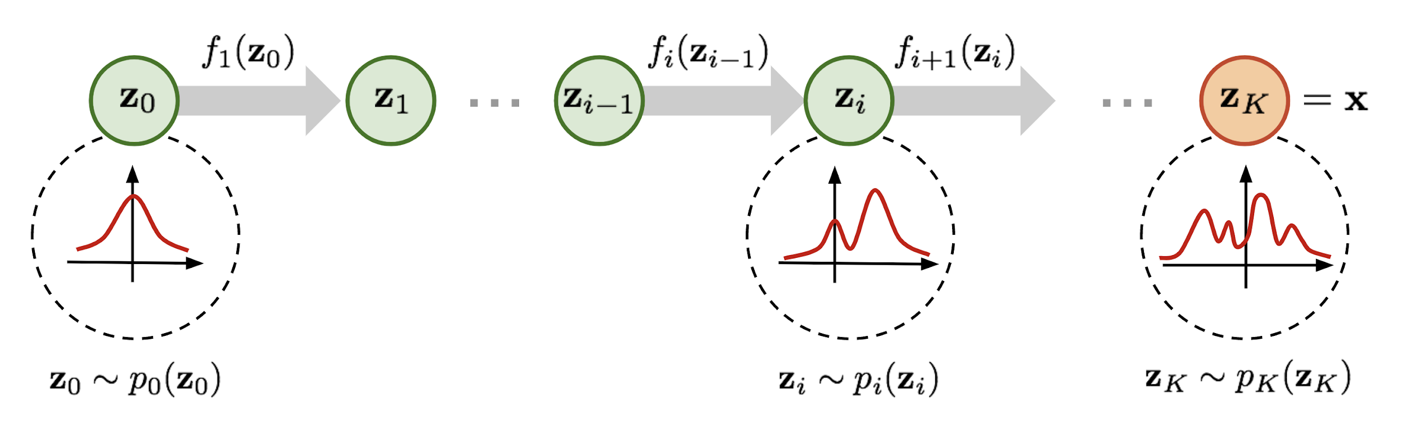
Normalizing Flow
Making posterior harder to collapse to a standard Gaussian prior
https://lilianweng.github.io/lil-log/2018/10/13/flow-based-deep-generative-models.html

Slide 7
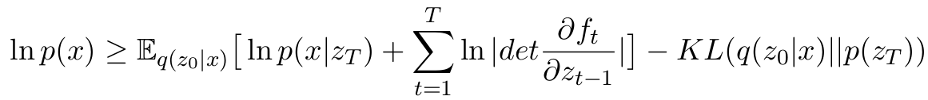
Normalizing Flow
Tighter likelihood approximation
Reconstruction
Jacobian
KL

Slide 8
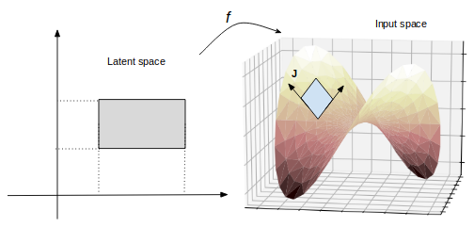
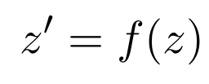
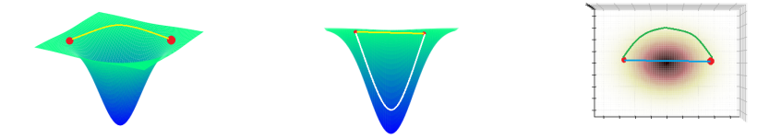
Why Riemannian VAE?
The Latent space is not flat Euclidean. It should be curved.

Slide 9
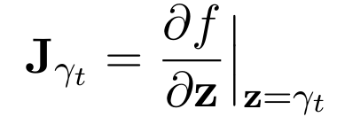

Riemannian Metric
Jacobian
Rie. Metric

Slide 10
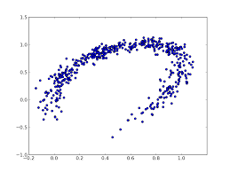
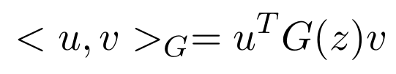
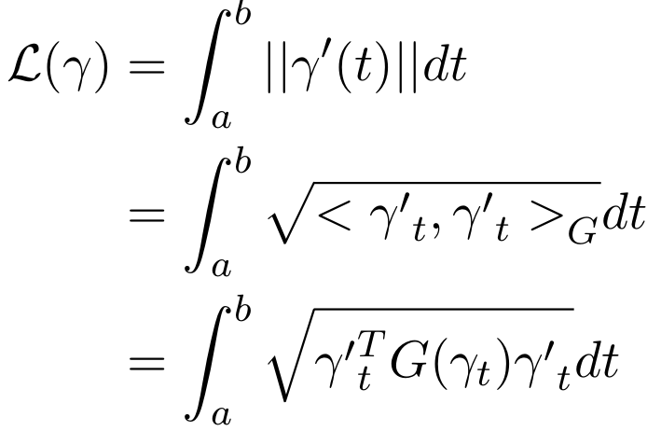
Match latent manifold with input manifold
Curve
Length

Slide 11

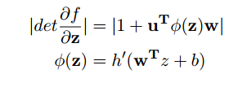

Modeling curvature by NF
Planar Flow
Curvature:

Slide 12
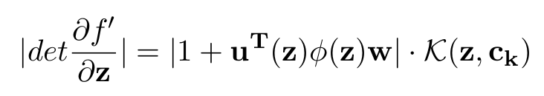
Modeling curvature by NF
To match geometry of latent space with input space, we need this determinant to be large when input manifold has high curvature
Jacobian

Slide 13
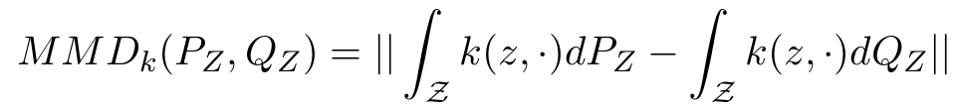
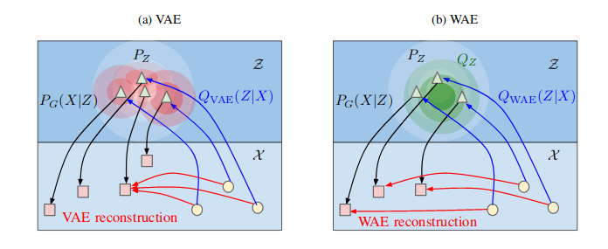
Wasserstein Distance
Wasserstein Autoencoder, (ICLR 2018, Ilya Tolstikhin)
Replace KL with Maximum Mean Discrepancy (MMD)

Slide 14
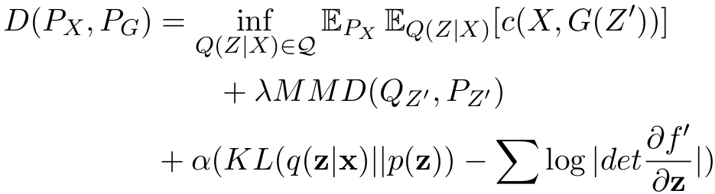
Wasserstein RNF
Reconstruction
MMD loss
KLD loss with NF

Slide 15
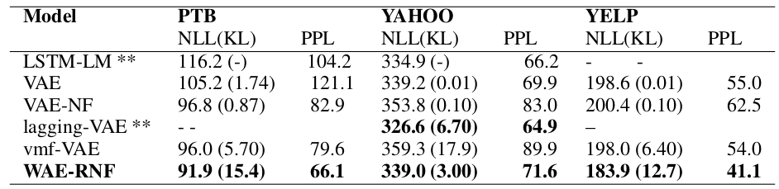
Results
Language Models: Negative Log-likelihood/KL/Perplexity

Slide 16
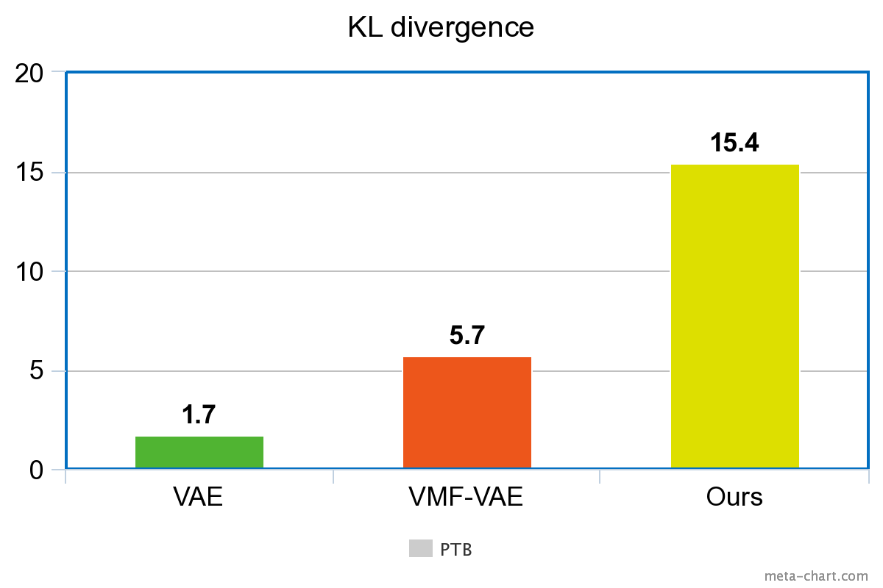
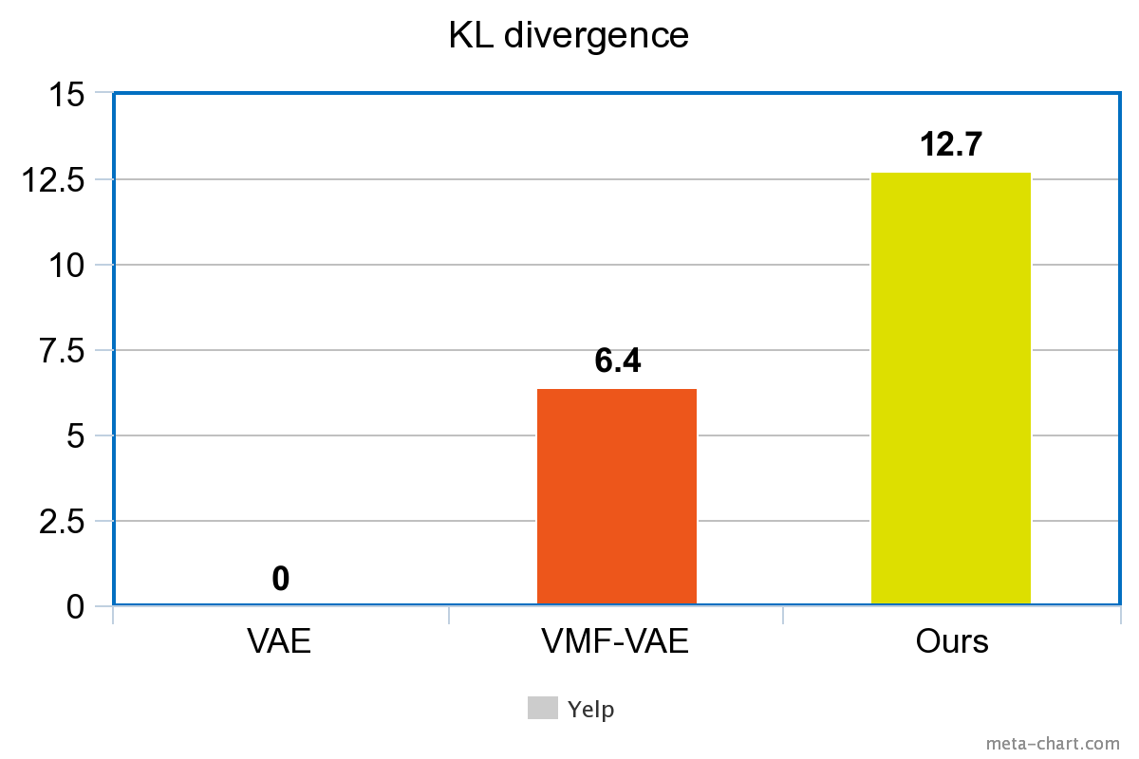
Results: KL divergence
PTB
Yelp

Slide 17
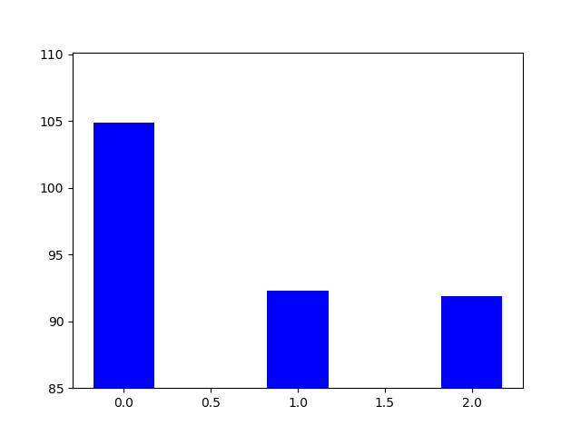
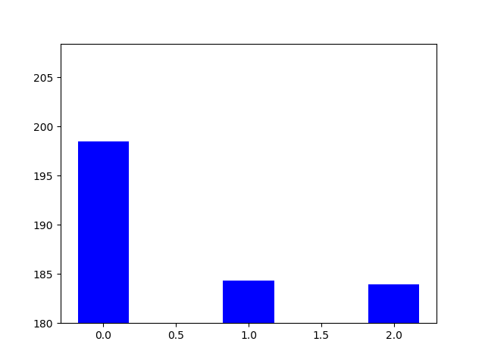
Results: Negative log-likelihood
PTB
Yelp
104
198
92
91
184
183
WAE
WAE-NF
WAE-RNF
WAE
WAE-NF
WAE-RNF

Slide 18
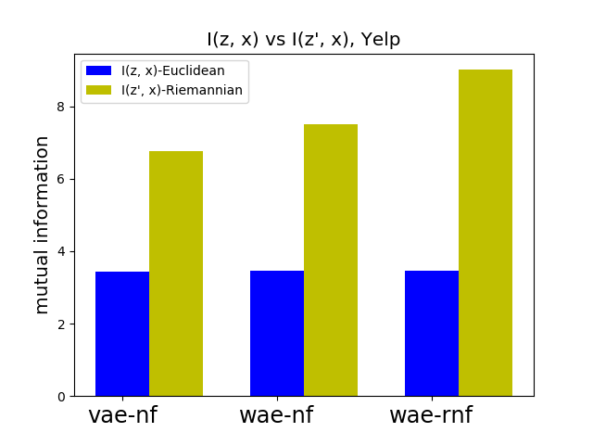
Mutual Information
Mutual information

Slide 19
Conclusion
Propose to use Normalizing Flow and Wasserstein Distance for variational language model
Design Riemannian Normalizing Flow to learn a smooth latent space
Empirical results indicate that Riemannian Normalizing Flow with Wasserstein Distance help avert KL vanishing
Code: https://github.com/kingofspace0wzz/wae-rnf-lm

Slide 20
Thank you! Q & A :)
Code: https://github.com/kingofspace0wzz/wae-rnf-lm
Paper: https://arxiv.org/abs/1904.02399

