Slide 1



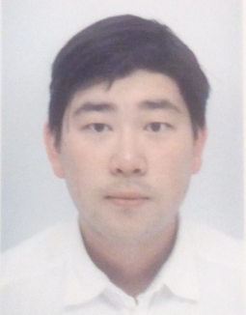
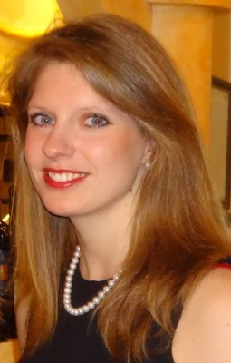


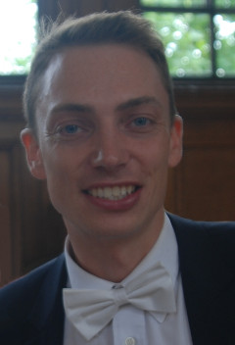

Text Processing Like Humans Do:
Visually Attaćking ӓnḓ Shiອlding NLP Systems
Șteffԑn Eger, Gözde Gül Şahin, Andrԑas Rücκlé, Ji-Ung ᒷee, ᑕlaựdia Schulz, Mohsԑn Mesgar, Krishῃĸant Swarǹkar, Eḏwin Simpson, Irγna Gurevych
Ubiquitous Knowledge Processing Lab
AIPHES Research Training Group
Technische Universität Darmstadt
https://www.ukp.tu-darmstadt.de/
https://www.aiphes.tu-darmstadt.de

Slide 2
Motivation
Human vs Machine Text Processing
Visual Perturber (VIPER)
Making NLP Systems more robust
Experiments & Results
Recap & Conclusion

Slide 3
Motivatįon

Slide 4







NLP out in the open

Slide 5
NLP out in the open
Spamming
Domain name spoofing
Toxic Comments

Slide 6


NLP out in the open
Spamming
Domain name spoofing
You idiot!
You have no idea!
Go to hell!
Toxic Comments

Slide 7
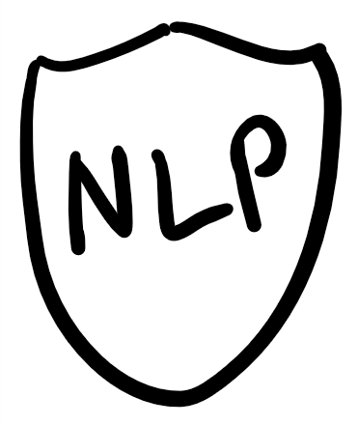
NLP out in the open
Spamming
Domain name spoofing
You idiot!
You have no idea!
Go to hell!
Toxic Comments

Slide 8

NLP out in the open
Spamming
Domain name spoofing
http://wíkipedia.org
You idіøƫ!
You have no ļḏea!
Go to ḥeΙļ!
Toxic Comments

Slide 9
NLP out in the open
Spamming
Domain name spoofing
http://wíkipedia.org
You idіøƫ!
You have no ļḏea!
Go to ḥeΙļ!
Toxic Comments

Slide 10
Humaņ vs Mḁchine ₮ext Proceșsing

Slide 11
Visually Attacking NLP Systems
Human
Machine
You idіøƫ !
You idіøƫ !

Slide 12

Visually Attacking NLP Systems
Human
Machine
You idіøƫ !
You idіøƫ !
You idіøƫ !

Slide 13
Visually Attacking NLP Systems
Human
Machine
You idіøƫ !
You idіøƫ !
You idіøƫ !
i d i o t

Slide 14

Visually Attacking NLP Systems
Human
Machine
You idіøƫ !
You idіøƫ !
You idіøƫ !
i d i o t
toxic

Slide 15
Visually Attacking NLP Systems
Human
Machine
You idіøƫ !
You idіøƫ !
i d i ø ƫ
105 100 111 248 427
You idіøƫ !
i d i o t
toxic

Slide 16

Visually Attacking NLP Systems
Human
Machine
You idіøƫ !
You idіøƫ !
i d i ø ƫ
105 100 111 248 427
You idіøƫ !
0.1
.
.
0.2
0.6
.
.
0.1
i d i o t
. . .
toxic

Slide 17

Visually Attacking NLP Systems
Human
Machine
You idіøƫ !
You idіøƫ !
i d i ø ƫ
105 100 111 248 427
You idіøƫ !
0.1
.
.
0.2
0.6
.
.
0.1
i d i o t
. . .
toxic
? ? ?

Slide 18

Visually Attacking NLP Systems
Human
Machine
You idіøƫ !
You idіøƫ !
i d i ø ƫ
105 100 111 248 427
You idіøƫ !
0.1
.
.
0.2
0.6
.
.
0.1
i d i o t
. . .
toxic
? ? ?

Slide 19
VIsųal PERturbeґ (VIPER)

Slide 20
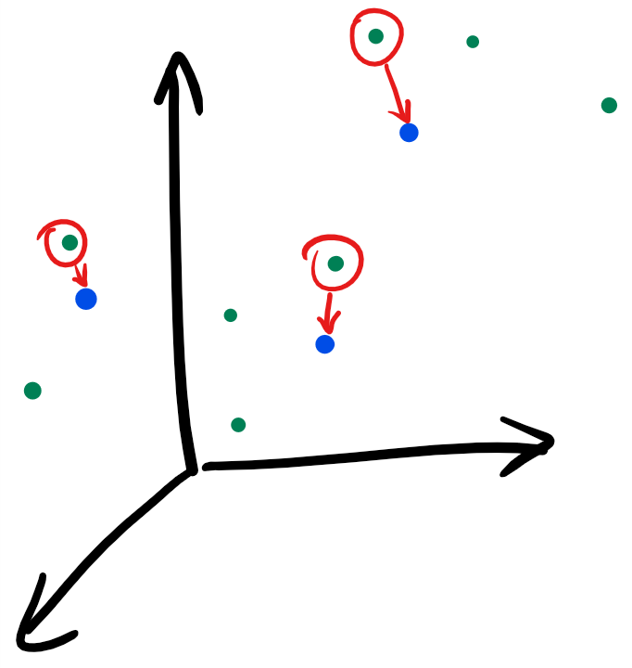
Creating Perturbations with VIPER
ḁ
Character embeddings
Use pixel values as initialization
Cosine similarity to obtain similar characters
a
ʂ
ᑭ
s
P

Slide 21
Attacking NLP Systems
Use VIPER to perturb characters
Test data
f u c k i n g
p = 0.9
ḟ u c k i n g

Slide 22
Attacking NLP Systems
Use VIPER to perturb characters
p : probability of perturbing a character
Test data
f u c k i n g
p = 0.9
ḟ u c k i n g

Slide 23
Attacking NLP Systems
Use VIPER to perturb characters
p : probability of perturbing a character
How do state-of-the-art models perform on perturbed test data?
Test data
f u c k i n g
? ? ?
p = 0.9
vs
ḟ u c k i n g
? ? ?

Slide 24
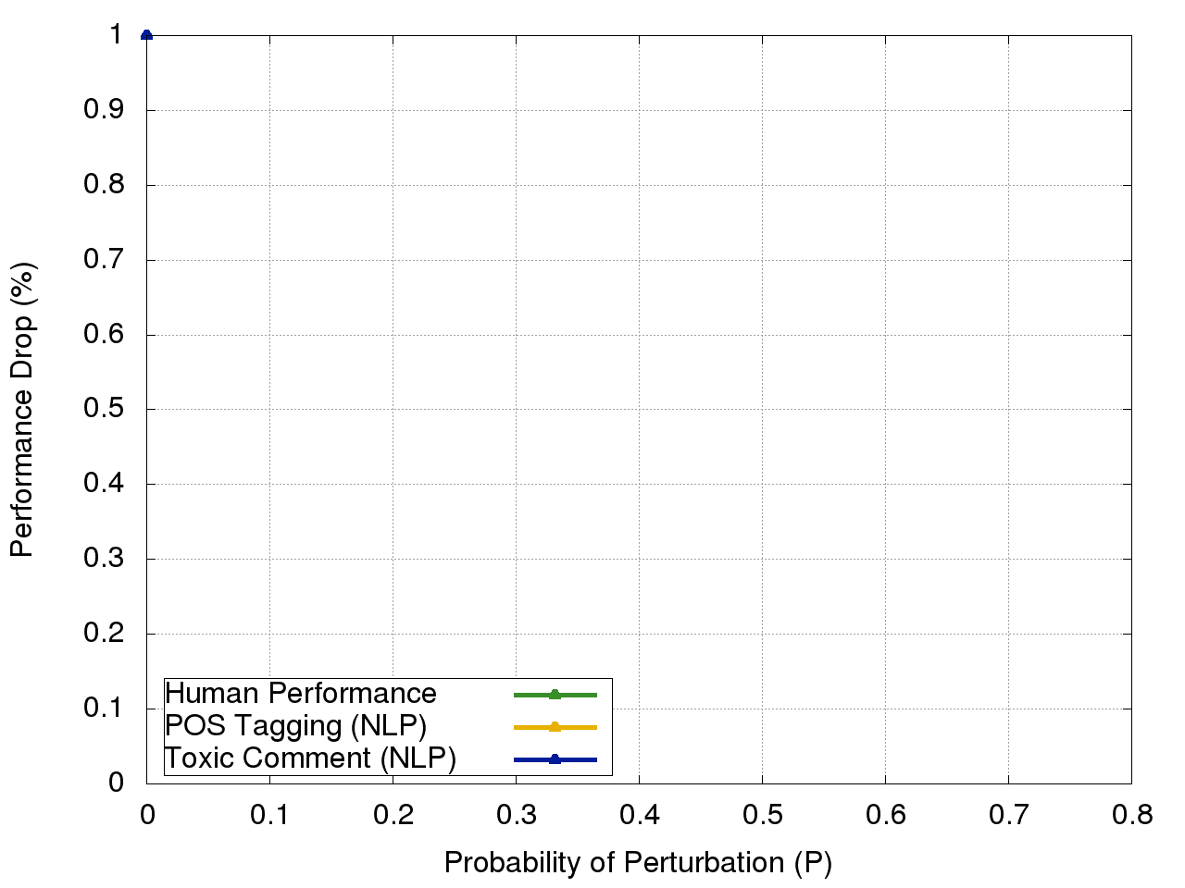
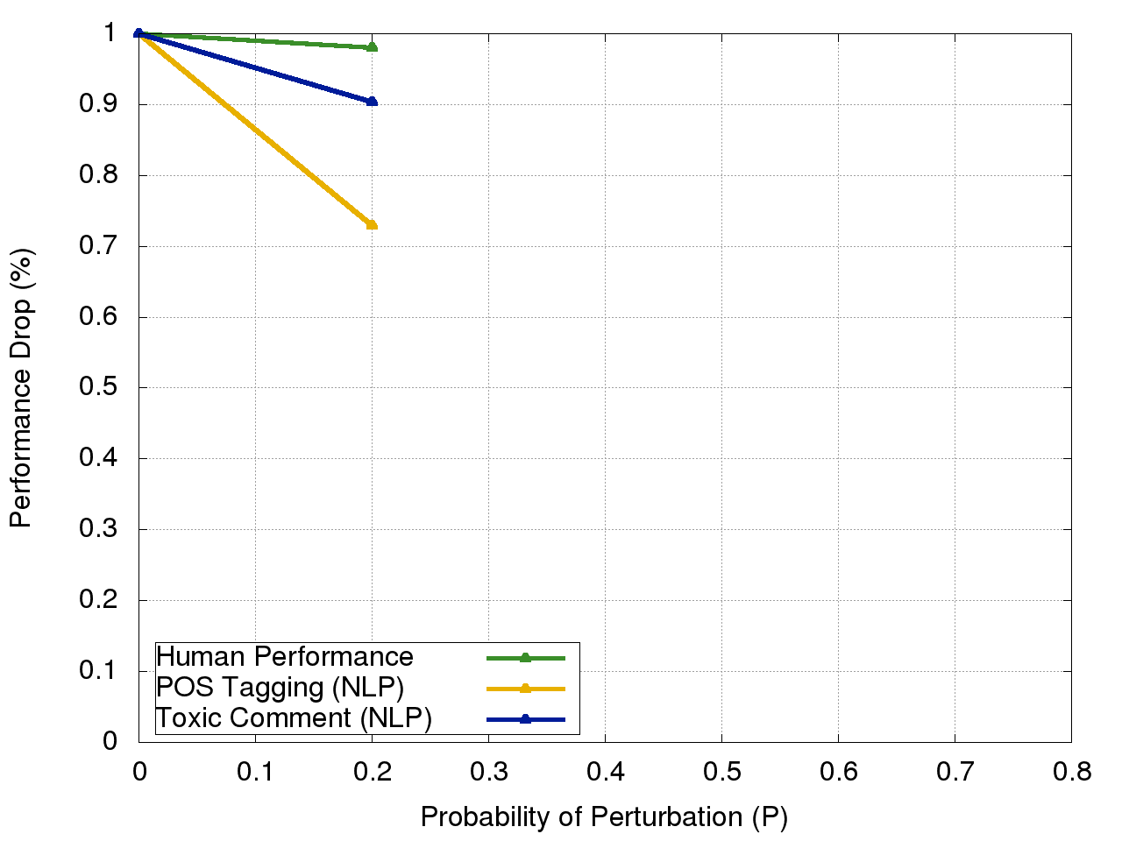
Human vs Machine Performance
0% Perturbance:
game over man !

Slide 25
Human vs Machine Performance
20% Perturbance:
game oveŕ mȃߒ !

Slide 26
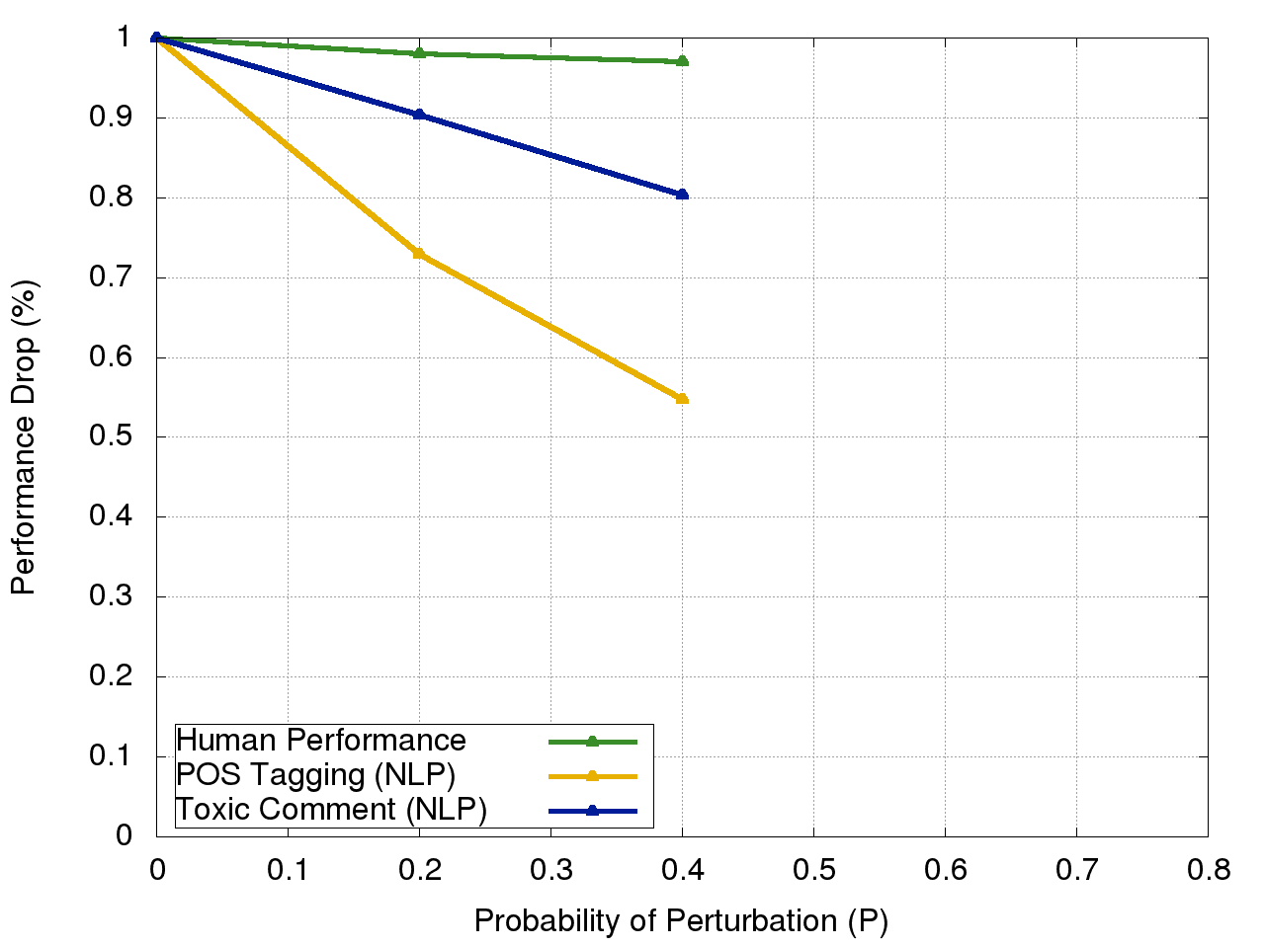
Human vs Machine Performance
40% Perturbance:
ǥamɜ ŏỽǝʀ ɱaƞ !

Slide 27
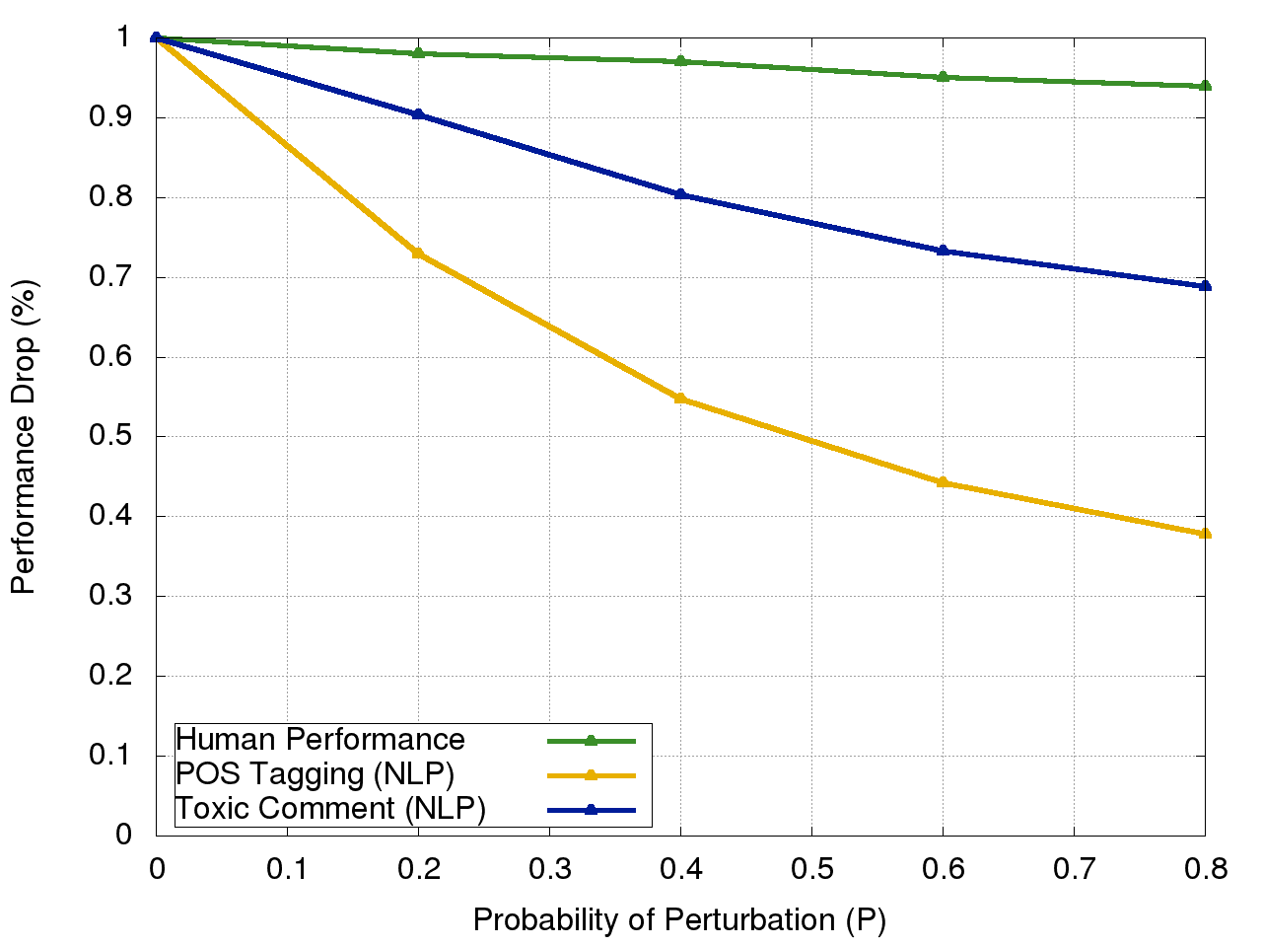
Human vs Machine Performance
80% Perturbance:
ḡǻmɇ oᶺêr ᶆaƞ !

Slide 28
Human vs Machine Performance
80% Perturbance:
ḡǻmɇ oᶺêr ᶆaƞ !
P = 0.8:
Human performance ~94%
Machine performance ~20-70%

Slide 29
Making NLᑭ Systems more robüsŧ

Slide 30
How to shield against such attacks?
Visually Informed Character Embeddings
Data Augmentation

Slide 31
How to shield against such attacks?
Visually Informed Character Embeddings
Data Augmentation

Slide 32
Visually Informed Character Embeddings
Visually uninformed
Visually informed
T h e c a t
T h e c a t

Slide 33
Visually Informed Character Embeddings
Visually uninformed
Visually informed
0.1
.
.
0.2
. . .
0.7
.
.
0.2
random init
T h e c a t
T h e c a t

Slide 34
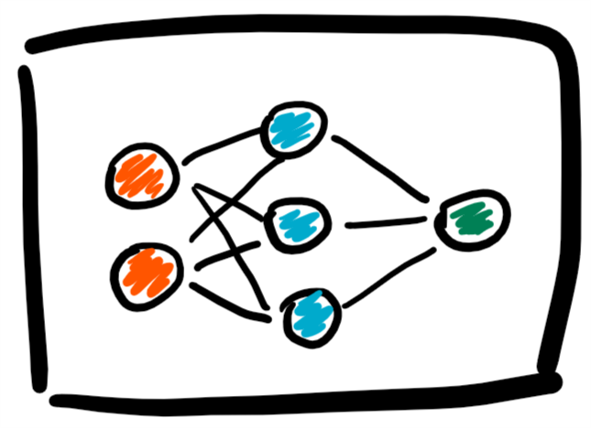

Visually Informed Character Embeddings
Visually uninformed
Visually informed
non-toxic
0.1
.
.
0.2
. . .
0.7
.
.
0.2
random init
T h e c a t
T h e c a t

Slide 35
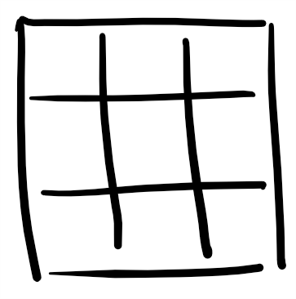
Visually Informed Character Embeddings
Visually uninformed
Visually informed
non-toxic
0.1
.
.
0.2
. . .
0.7
.
.
0.2
random init
pixel images
T h e c a t
T h e c a t

Slide 36
Visually Informed Character Embeddings
Visually uninformed
Visually informed
non-toxic
0.1
.
.
0.2
0.7
.
.
0.2
0.5
.
.
0.3
. . .
0.8
.
.
0.1
. . .
random init
pixel images
T h e c a t
T h e c a t

Slide 37
Visually Informed Character Embeddings
Visually uninformed
Visually informed
non-toxic
non-toxic
0.1
.
.
0.2
0.7
.
.
0.2
0.5
.
.
0.3
. . .
0.8
.
.
0.1
. . .
random init
pixel images
T h e c a t
T h e c a t

Slide 38
Visually Informed Character Embeddings
No random initialization of character embeddings
Use concatenated pixel values
non-toxic
0.5
.
.
0.3
. . .
0.8
.
.
0.1
pixel images
T h e c a t

Slide 39
Visually Informed Character Embeddings
No random initialization of character embeddings
Use concatenated pixel values
Visual similarities can now be learned during training
More likely to generalize better to new characters during testing
non-toxic
0.5
.
.
0.3
. . .
0.8
.
.
0.1
pixel images
T h e c a t

Slide 40
How to shield against such attacks?
Visually Informed Character Embeddings
Data Augmentation

Slide 41
Adversarial Training
Training data
f u c k i n g

Slide 42
Adversarial Training
Enrich training data with perturbations
[Goodfellow et al, 2015]
. . .
p = 0.2
Training data
f u c k i n g

Slide 43
Adversarial Training
Enrich training data with perturbations
[Goodfellow et al, 2015]
0.5
.
.
0.3
. . .
0.8
.
.
0.1
. . .
ḟ u c k i n g
. . .
p = 0.2
Training data
f u c k i n g

Slide 44
Adversarial Training
Enrich training data with perturbations
[Goodfellow et al, 2015]
toxic
0.5
.
.
0.3
. . .
0.8
.
.
0.1
. . .
ḟ u c k i n g
. . .
p = 0.2
Training data
f u c k i n g

Slide 45
Adversarial Training
Enrich training data with perturbations
[Goodfellow et al, 2015]
Seeing perturbed data during training allows the model to recognize it during testing
toxic
0.5
.
.
0.3
. . .
0.8
.
.
0.1
. . .
ḟ u c k i n g
. . .
p = 0.2
Training data
f u c k i n g

Slide 46
Exᵽeriments & Results

Slide 47
General Setup
ELMo embeddings [Peters et al, 2018]

Slide 48
General Setup
ELMo embeddings [Peters et al, 2018]
Evaluation on four downstream tasks:
  Character level:
    Grapheme to phoneme conversion
  Word level:
    PoS Tagging
    Chunking
  Sentence level:
    Toxic comment classification

Slide 49
General Setup
ELMo embeddings [Peters et al, 2018]
Evaluation on four downstream tasks:
  Character level:
    Grapheme to phoneme conversion
  Word level:
    PoS Tagging
    Chunking
  Sentence level:
    Toxic comment classification
Different embedding spaces for generating perturbed test data

Slide 50
General Setup
ELMo embeddings [Peters et al, 2018]
Evaluation on four downstream tasks:
  Character level:
    Grapheme to phoneme conversion
  Word level:
    PoS Tagging
    Chunking
  Sentence level:
    Toxic comment classification
Different embedding spaces for generating perturbed test data

Slide 51
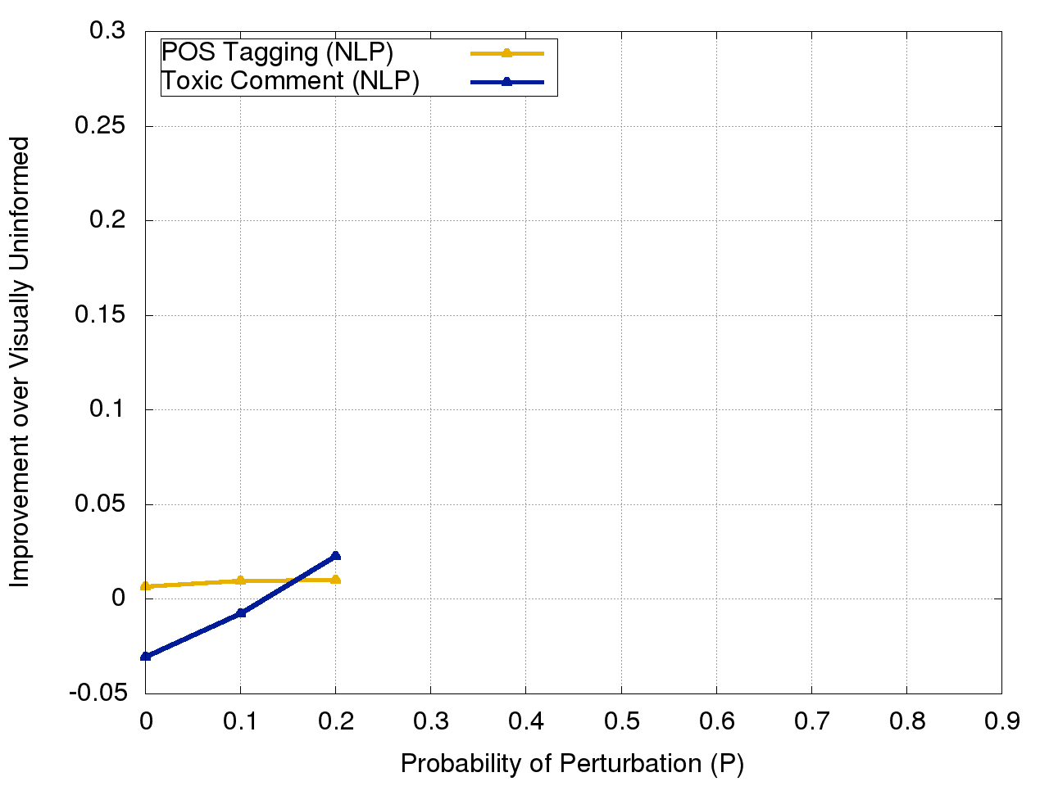
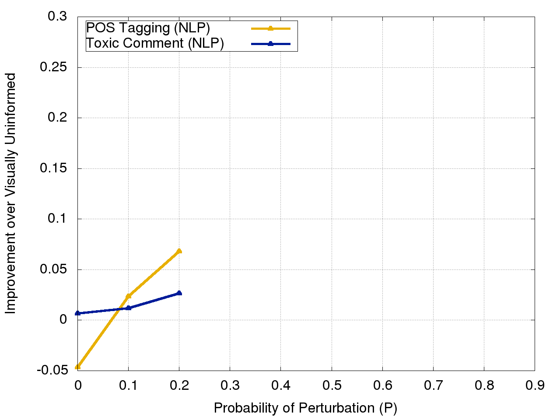
Results
Visually informed
20% Perturbance:
adversarial training
game oveŕ mȃߒ !
Pos Tagging
Toxic Comment
Pos Tagging
Toxic Comment
Improvement over Visually Uninformed
Improvement over Visually Uninformed
Probability of Perturbation (P)
Probability of Perturbation (P)

Slide 52
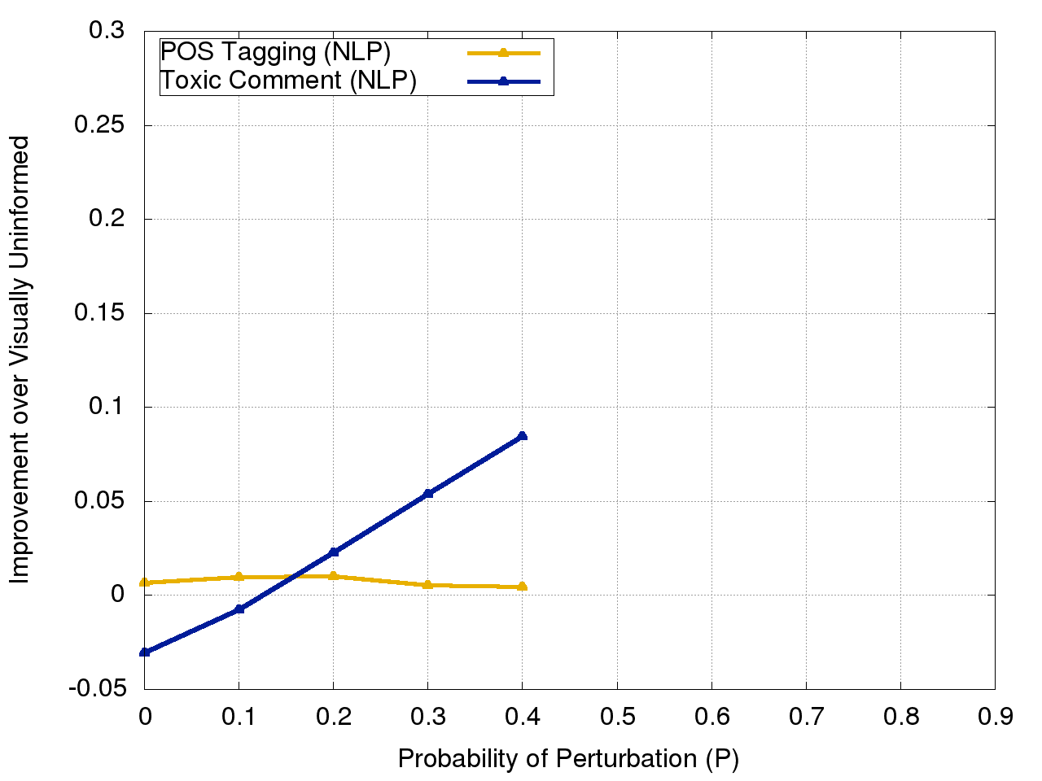
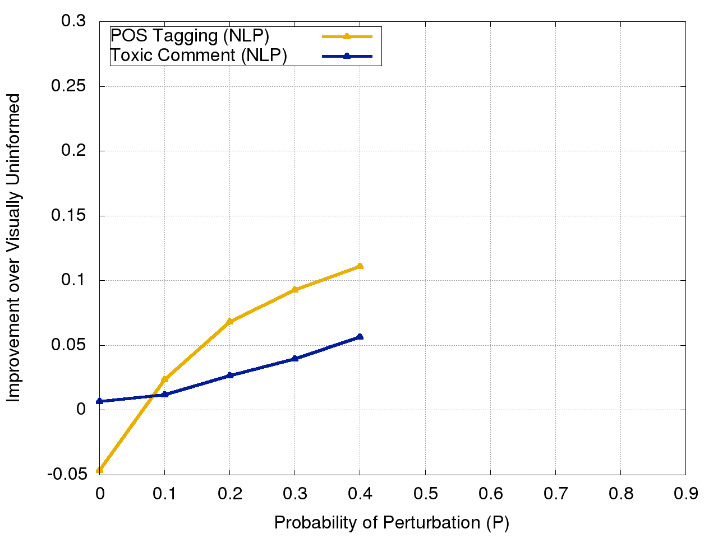
Results
Visually informed
40% Perturbance:
adversarial training
ǥamɜ ŏỽǝʀ ɱaƞ !
Pos Tagging
Toxic Comment
Pos Tagging
Toxic Comment
Improvement over Visually Uninformed
Improvement over Visually Uninformed
Probability of Perturbation (P)
Probability of Perturbation (P)

Slide 53
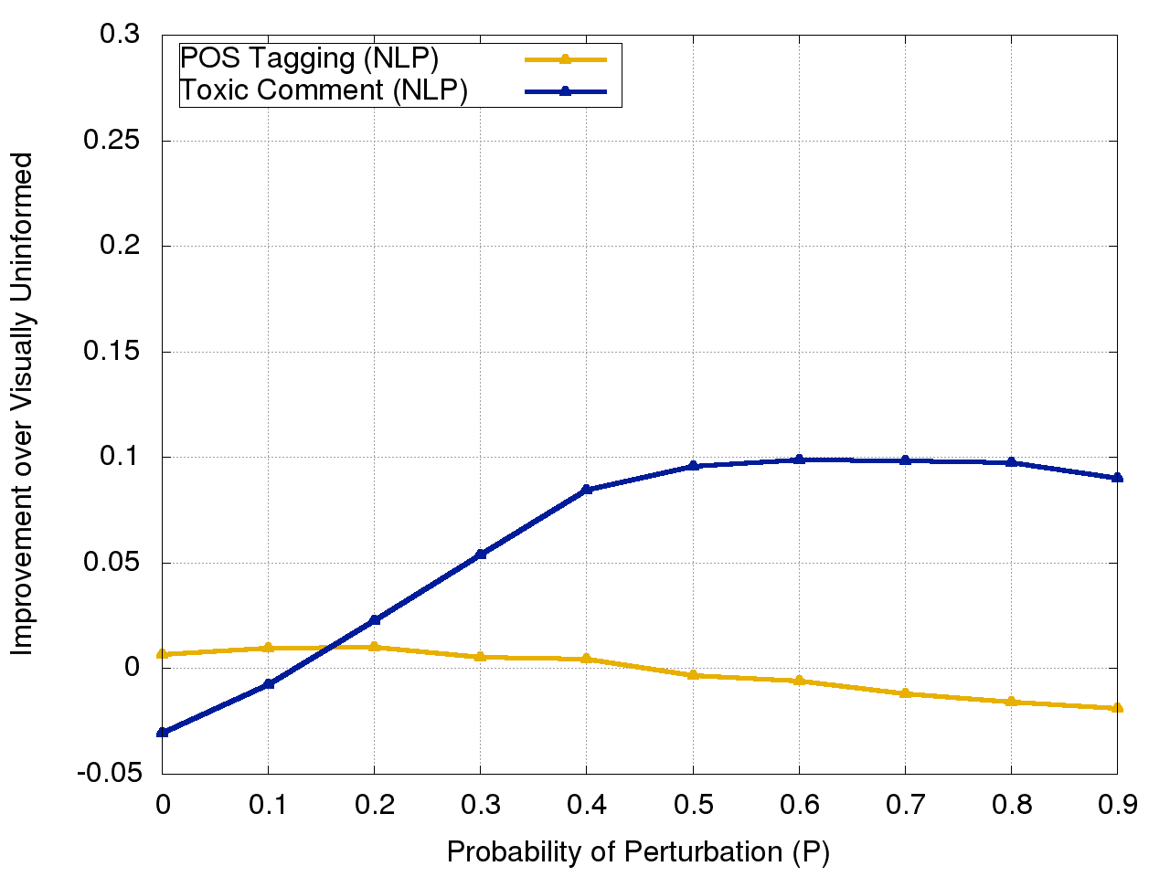
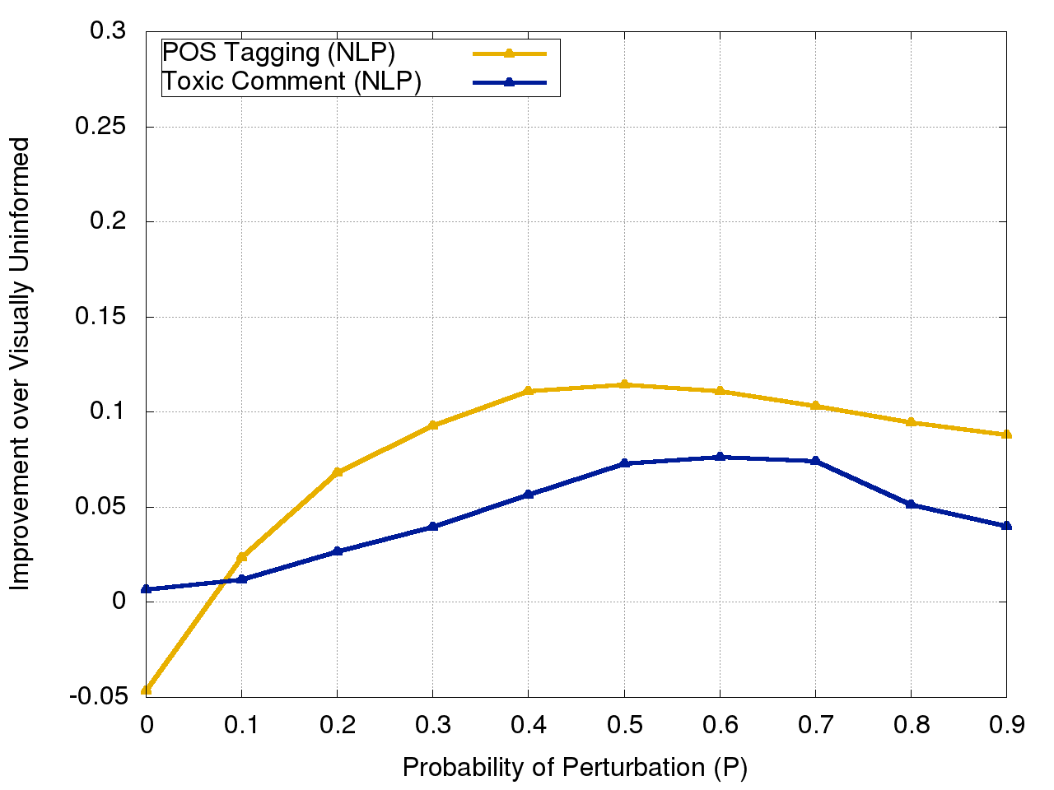
Results
Visually informed
80% Perturbance:
adversarial training
ḡǻmɇ oᶺêr ᶆaƞ !
Pos Tagging
Toxic Comment
Pos Tagging
Toxic Comment
Improvement over Visually Uninformed
Improvement over Visually Uninformed
Probability of Perturbation (P)
Probability of Perturbation (P)

Slide 54
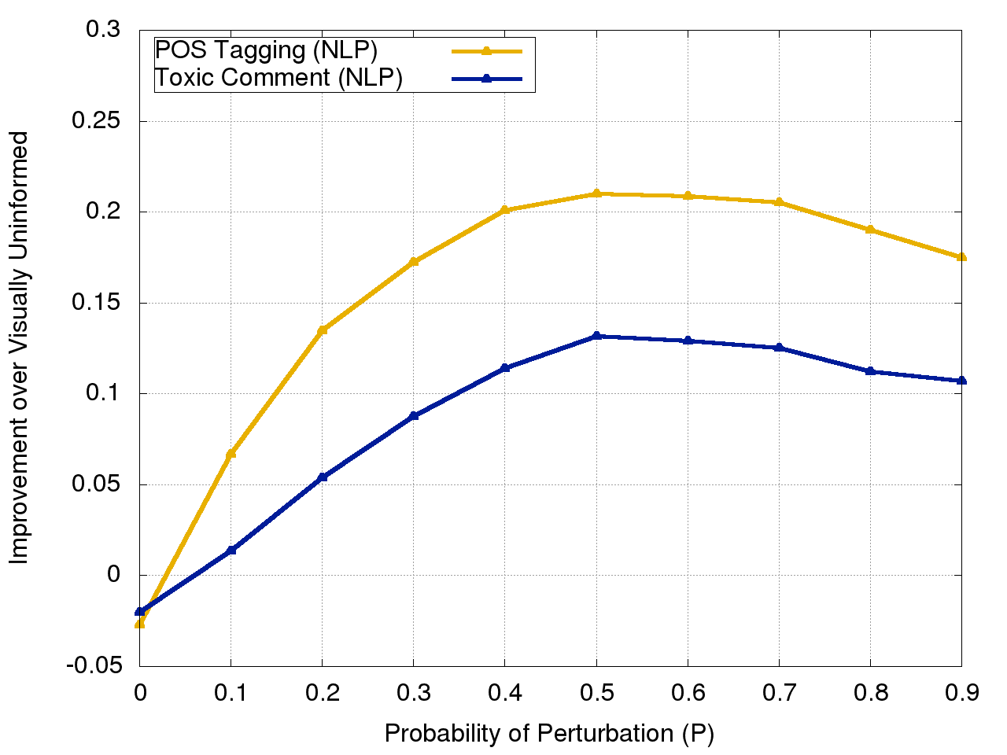
Results
Visually informed + adversarial training
Pos Tagging
Toxic Comment
Improvement over Visually Uninformed
Probability of Perturbation (P)

Slide 55
Recap
Machine
i d і ø ƫ
toxic

Slide 56
Recap
Machine
Data
Augmentation
i d і ø ƫ
Training data
toxic

Slide 57
Recap
Machine
Data
Augmentation
i d і ø ƫ
Visual
Information
Training data
ḟ
toxic

Slide 58
So doeʂ ⅰt heΙp ?

Slide 59
Conclusion
ỾES!
We were able to make NLP systems more robust
The suggested methods improve the performance on perturbed data
Combining visually informed embeddings with adversarial training is very helpful

Slide 60
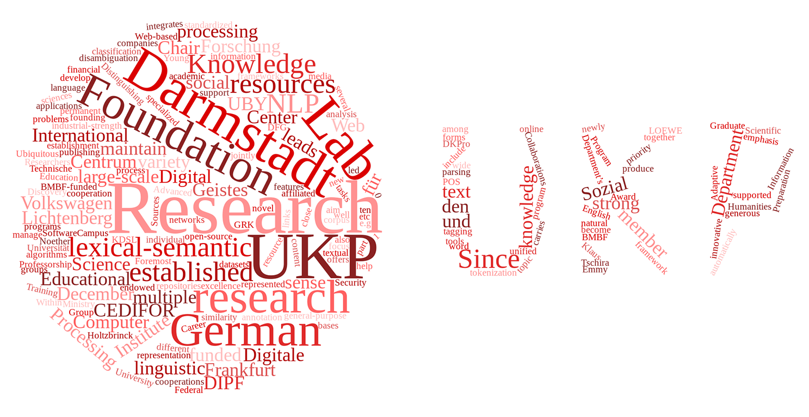
Thank you for listening!
https://github.com/UKPLab/naacl2019-like-humans-visual-attacks

Slide 61
References
Frederick Liu, Han Lu, Chieh Lo, and Graham Neubig. 2017. Learning character-level composition-ality with visual features. InProceedings of the 55th Annual Meeting of the Association for Computational Linguistics, ACL 2017, Vancouver, Canada,July 30 - August 4, Volume 1: Long Papers, pages 2059–2068
Matthew Peters, Mark Neumann, Mohit Iyyer, Matt Gardner, Christopher Clark, Kenton Lee, and Luke Zettlemoyer. 2018. Deep contextualized word representations. In Proceedings of the 2018 Conference of the North American Chapter of the Association for Computational Linguistics: Human Language Technologies, Volume 1 (Long Papers), pages 2227–2237. Association for Computational Linguistics.
Ian Goodfellow, Jonathon Shlens, and Christian Szegedy. 2015. Explaining and harnessing adversarial examples. In International Conference on Learning Representations.

